Slide 1
Asynchronous programming. Threads

Slide 2
Table of content
Threads Concept
Thread Basics
Threading Module
Functions as threads
Access to Shared Data
Race Conditions

Slide 3
Concept: Threads
What most programmers think of when they hear about "concurrent programming“
An independent task running inside a program
Shares resources with the main program (memory, files, network connections, etc.)
Has its own independent flow of execution (stack, current instruction, etc.)

Slide 4
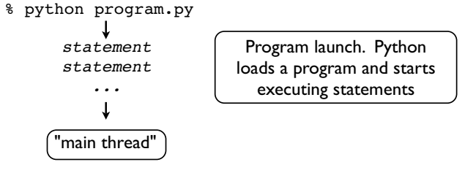
Thread Basics

Slide 5
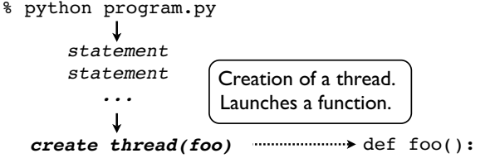
Thread Basics

Slide 6
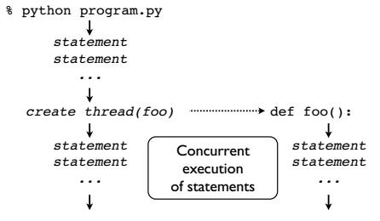
Thread Basics

Slide 7
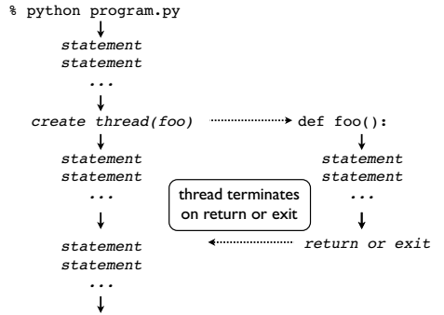
Thread Basics

Slide 8
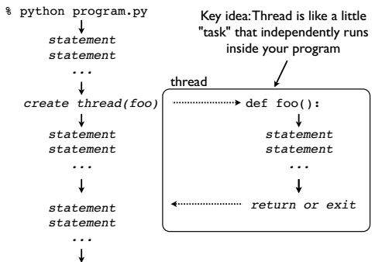
Thread Basics

Slide 9
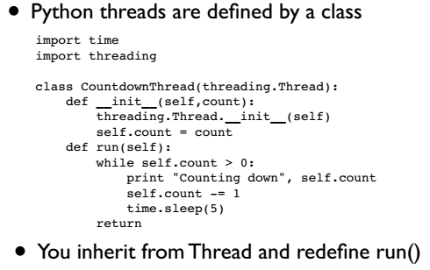
Threading Module

Slide 10
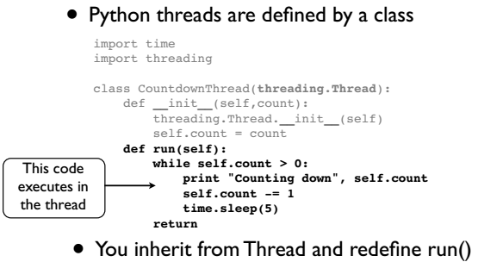
Threading Module
Notes:
Old python 2.x code. Run and init methods can be overwritten only

Slide 11
Threading Module
Notes:
Old python 2.x code. Run and init methods can be overwritten only

Slide 12
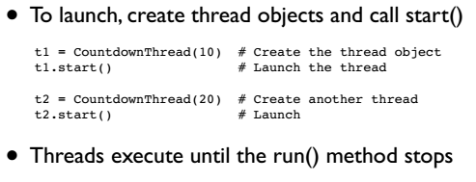
Threading Module
Notes:
Old python 2.x code. Run and init methods can be overwritten only

Slide 13
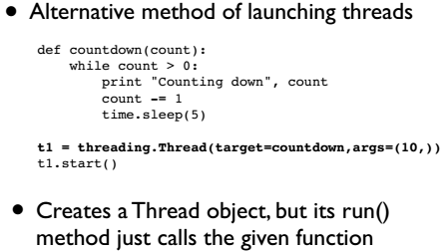
Functions as threads
Notes:
Old python 2.x code. Run and init methods can be overwritten only

Slide 14
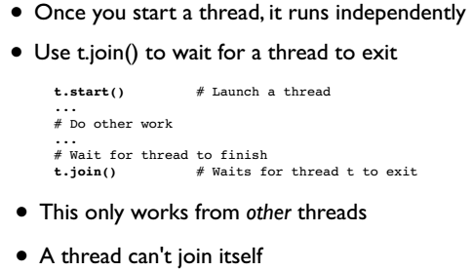
Joining a Thread
Notes:
Old python 2.x code. Run and init methods can be overwritten only

Slide 15
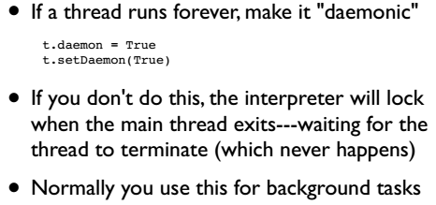
Daemonic Thread
Notes:
Old python 2.x code. Run and init methods can be overwritten only

Slide 16
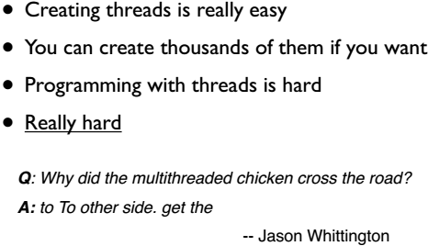
Interlude
Notes:
Old python 2.x code. Run and init methods can be overwritten only

Slide 17
Access to Shared Data
Threads share all of the data in your program
Thread scheduling is non-deterministic
Operations often take several steps and might be interrupted mid-stream (non-atomic)
Thus, access to any kind of shared data is also non-deterministic (which is a really good way to have your head explode)
Notes:
Old python 2.x code. Run and init methods can be overwritten only

Slide 18
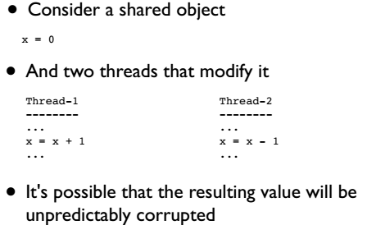
Accessing Shared Data
Notes:
Old python 2.x code. Run and init methods can be overwritten only

Slide 19
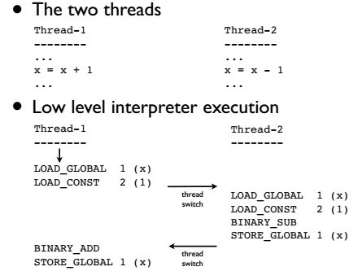
Accessing Shared Data
Notes:
Old python 2.x code. Run and init methods can be overwritten only

Slide 20
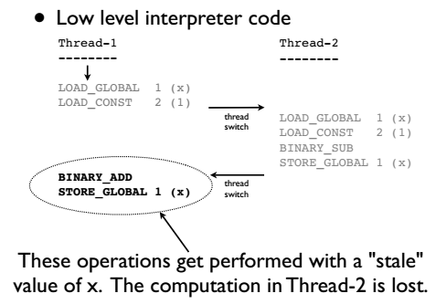
Accessing Shared Data
Notes:
Old python 2.x code. Run and init methods can be overwritten only

Slide 21
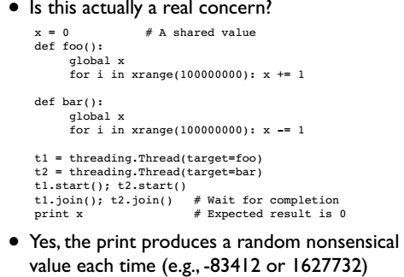
Accessing Shared Data
Notes:
Old python 2.x code. Run and init methods can be overwritten only

Slide 22
Race Conditions
The corruption of shared data due to thread scheduling is often known as a "race condition.“
It's often quite diabolical--a program may produce slightly different results each time it runs (even though you aren't using any random numbers)
Or it may just flake out mysteriously once every two weeks
Notes:
Old python 2.x code. Run and init methods can be overwritten only

Slide 23
Thread Synchronization
Identifying and fixing a race condition will make you a better programmer (e.g., it "builds character")
However, you'll probably never get that month of your life back...
To fix : You have to synchronize threads
Notes:
Old python 2.x code. Run and init methods can be overwritten only

